Slide 1

Credit Card Default Prediction

Slide 2
Credit Card Default Prediction
The Credit Card Default Prediction Machine Learning project aims to develop a predictive model to assess the likelihood of credit card default by utilizing historical transactional and customer data

Slide 3
Proposed Solution
The project follows a supervised learning approach, utilizing a dataset containing a comprehensive range of features, including credit limit, payment history, amount owed, age, etc. Various machine learning algorithms, such as logistic regression, decision trees, random forests, and gradient boosting, were explored and compared. Feature engineering techniques, including Weight of Evidence, were employed to enhance model performance. AUC ROC GINI are the metrics used for model validation

Slide 4






Tools and technology

Slide 5
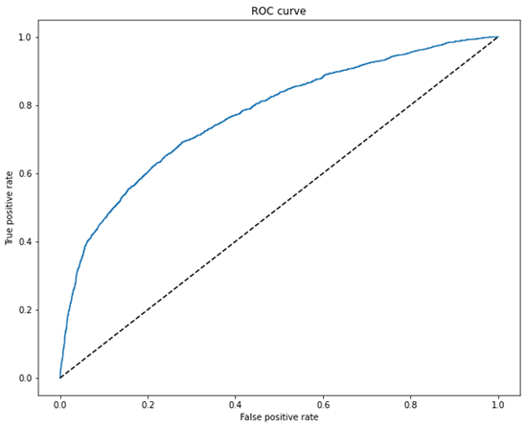
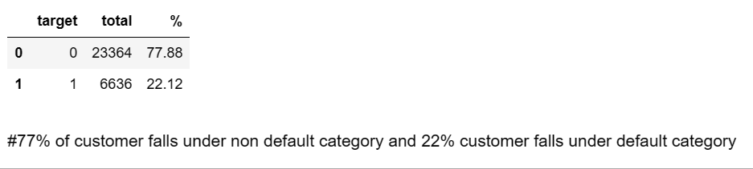
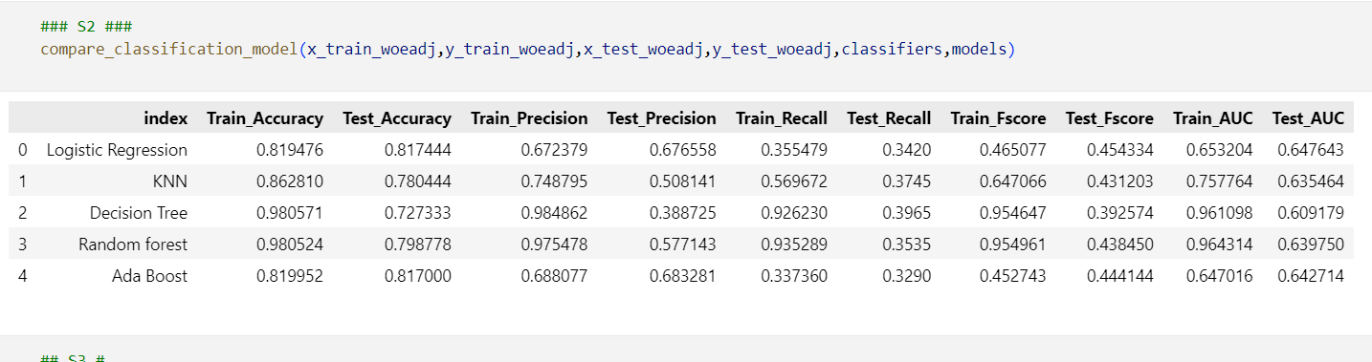
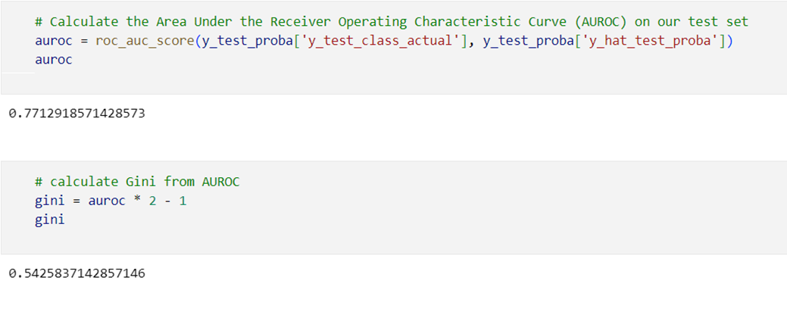
Model metrics

Slide 6
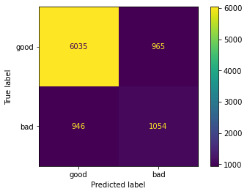
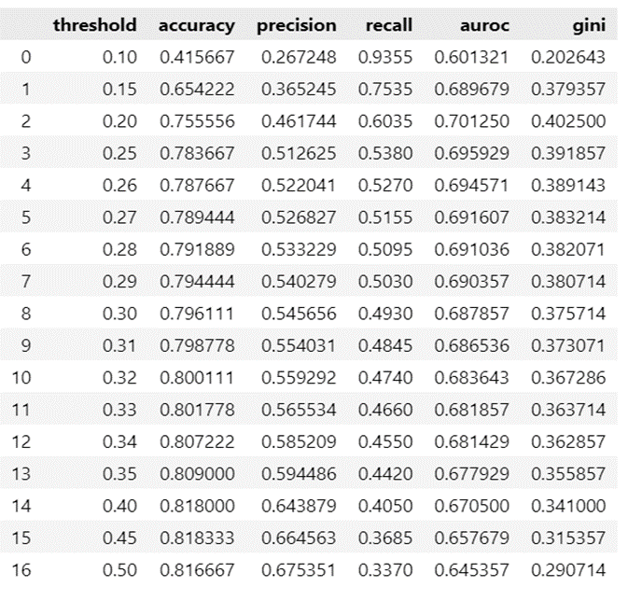
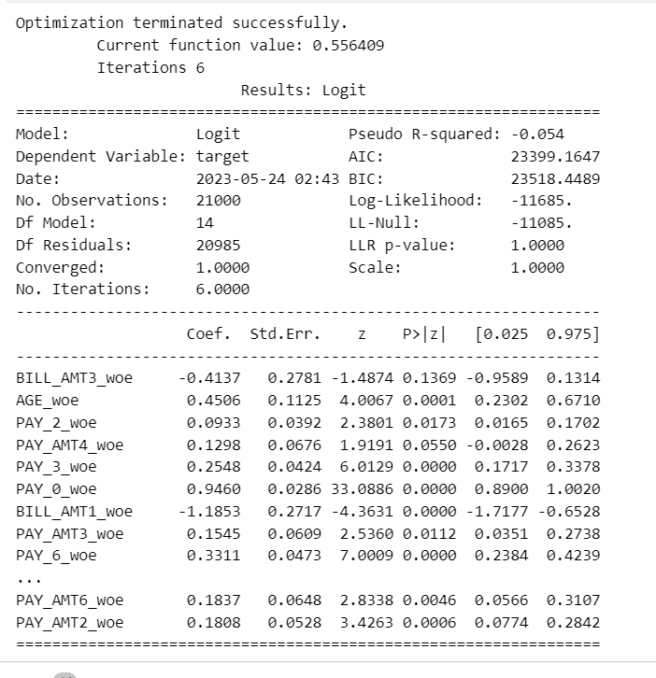
Result

